Slide 1

Meet the Teacher evening
2025

Slide 2
Overview
Lessons and assessments
Subjects covered
SATs
Homework
Routines and systems
Uniform
Snacks and Lunch
Parent/Teacher communication procedures
Trips
Home reading
Expectations in Year 5/6

Slide 3
Aims
Cater to every child's needs.
Provide challenge and success in learning.
Provide a means to enable all to access the learning.
Provide a safe and happy learning environment.

Slide 4
Welcome to Year 5/6!

Slide 5
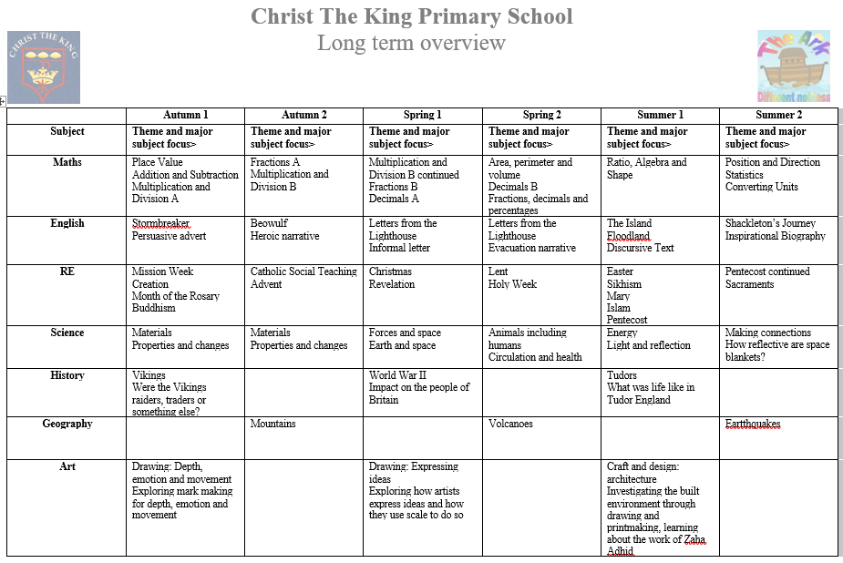

Slide 6
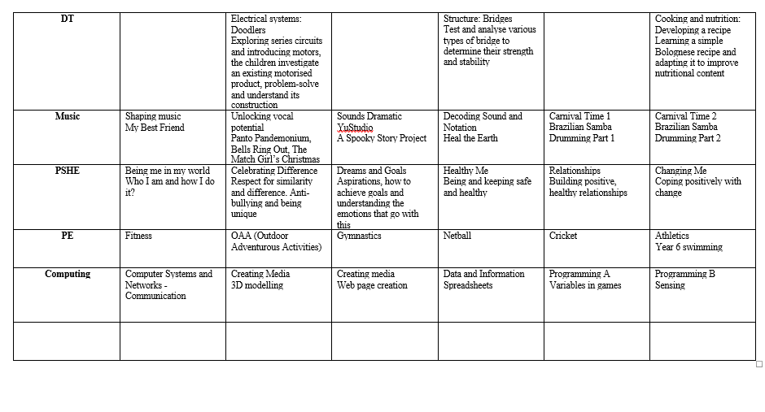

Slide 7
National Curriculum Tests – SATs 11th May
Maths - 3 papers: Paper 1 Arithmetic Paper 2 and 3 Reasoning
English – Reading Paper
Spelling, Punctuation and Grammar papers (SPaG)

Slide 8
Homework
English and Maths every week
This will usually consist of:
- An arithmetic test
- Some form of written work
- Spellings
- Grammar and punctuation (covered in class)
- Read Theory
Other homework tasks as appropriate.

Slide 9
Routines and Systems
Text messaging service – please make sure we always have up-to-date contact details
Letter to your child’s teacher with any concerns
Walking home - letters must be returned to class. This can obviously change throughout the year.

Slide 10
Uniform
Smart uniforms please – please ensure this is named
No trainers
Children to wear their PE kit to school
PE is every Wednesday.

Slide 11
Snacks and Lunch
Please ensure a healthy snack is brought in for break time
As a school we encourage healthy eating and appreciate your support with healthy lunches
If you have any concerns that your child may not be eating properly, or finishing all their lunch, please let us know. We will keep you informed if we have any concerns in school.

Slide 12
Parent / Teacher Communication
Parent evenings – Autumn Term
Monday 13th October 3.45pm
Wednesday 15th October 4pm
Parent evenings – Spring Term
Reports – Summer Term
Newsletters
Website –www.christthekingreading.co.uk
If you do have any concerns about your child, we are available after school in the playground. Or alternatively, please contact the office to arrange an appointment.

Slide 13
Y5/6 trips
Possible trips we are hoping to plan:
Trip to the REP Theatre
Sponsored Walk Green Park

Slide 14
Year 6 Enrichment Week
Sadly, due to increasing costs, it has been decided that there will be no residential this year.
However, to celebrate the end of the children’s time at Christ the King, we will be organising an Enrichment Week.
The proposed dates are Monday 29th June 2026 to Friday 3rd July 2026 and we are currently looking into day trips to the following locations:
Dinton Pastures Activity Centre
Marwell Zoo
Chessington
Go Ape
Cinema
Obviously, there will be a cost for these activities and we can offer a payment plan. More details will follow soon.

Slide 15
Reading at home
The children should be reading a range of texts (including classics and more challenging books) at home daily, approximately 20 minutes, including reading to an adult to discuss vocabulary use in context.
Reading records this year, the children have an opportunity to discuss their reading, in depth, with us weekly.
We do appreciate your support in emphasising the importance of daily reading.

Slide 16
Expectations in Year 5/6
For even the most confident of pupils (and their parents) the move into Year 5/6 can be a daunting time, but it really doesn’t have to be. Being in Year 5/6 truly is the most memorable time in your child’s primary education. It is a key moment in your child’s life; they will develop more independence, a huge amount of resilience and, most importantly, they should become very aware of who they are as both learners and as young adults.
We do hope they will rise to the challenge!

Slide 17
From you…
Letters for collection arrangements
Information regarding absence
If your child is to be excused from PE
Absence requests
Through calling the office or a letter to us which we’ll forward to the office.

Slide 18
Thank you for coming!
Any questions?

