Slide 1

Christ the King Catholic Nursery and Primary School
Hedgehogs Meeting
23rd September 2026

Slide 2
Welcome to Hedgehogs
Early Years Foundation Stages
Ms Ip Mrs Burton Mrs Emmett-Church

Slide 3
School times
8:40am - gates open
3:20pm - gates open
Prompt pick up and drop off please

Slide 4
Things to Remember Every Day
Water bottle
Fruit/veg snack
Full uniform
Book bag
PE kit
Notes:
Named everything
Pe Kit from same supplier – include pants and socks
PE Kits sent home if dirty or halft termly – are we still wearing them in everyday
Book Bag – keyring for easy of identification
Must be in school everyday and checked nightly when you hear your child read
Free if all forms are returned to school completed?

Slide 5
Clubs
Breakfast Club After School Club
Times: 07:30 – 08:30 Times: 15:20 – 18:00
Notes:
Children will be given breakfast before school. Between 08:30 and the start of school, children are supervised on the playground. Until October half term, Reception children at breakfast club come to the classroom rather than going out onto the playground.
ASC Children attending a full session will be given a light tea.
Payment: Price being reviewed. Breakfast and After School club must be booked and paid for in advance using your online account. Accounts and Passwords will be given out in September,

Slide 6


Lunch
All children in EYFS are offered a free school lunch.
This lunch includes a vegetarian and jacket potato option.
Children currently have the option to purchase additional drinks at a small charge.
Snack and Milk
Notes:
Lunch – children can provide their own lunch. Please note that we are a nut free school.
Fruit
Fruit is provided everyday for all children. The fruit changes from day to day so if your child has an allergy of any kind, please let us know as soon as possible.
Milk
Milk is provided every day for your child until they reach their fifth birthday. Please let us know if your child is allergic to milk.

Slide 7
Our Early Years classroom is a place where learning comes alive through play, exploration and discovery.

Slide 8



The EYFS curriculum is divided into: Prime Areas These are the foundations for all learning: Communication and Language Personal, Social and Emotional Development Physical Development
Notes:
The Early oundation Stage (EYFS) curriculum is designed to support children's learning and development through a balance of play, exploration and purposeful teaching. It focuses on seven key areas of learning that help children develop their communication, confidence, independence, creativity and understanding of the world. Through engaging experiences and positive relationships, we ensure every child is supported to thrive and reach their full potential.
Years F

Slide 9
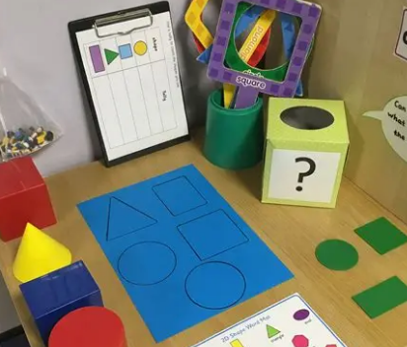


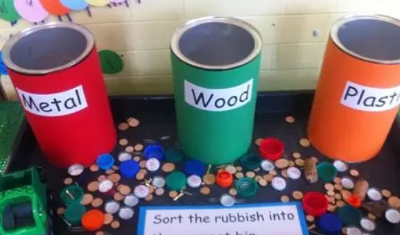
The EYFS curriculum is divided into: Specific Areas These build on and strengthen the prime areas: Literacy Mathematics Understanding the World Expressive Arts and Design
Notes:
The Early oundation Stage (EYFS) curriculum is designed to support children's learning and development through a balance of play, exploration and purposeful teaching. It focuses on seven key areas of learning that help children develop their communication, confidence, independence, creativity and understanding of the world. Through engaging experiences and positive relationships, we ensure every child is supported to thrive and reach their full potential.
Years F

Slide 10
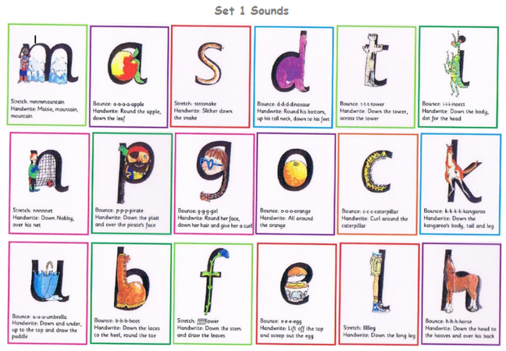
Homework
In the first term your child will have a set of new sounds to learn.

Slide 11
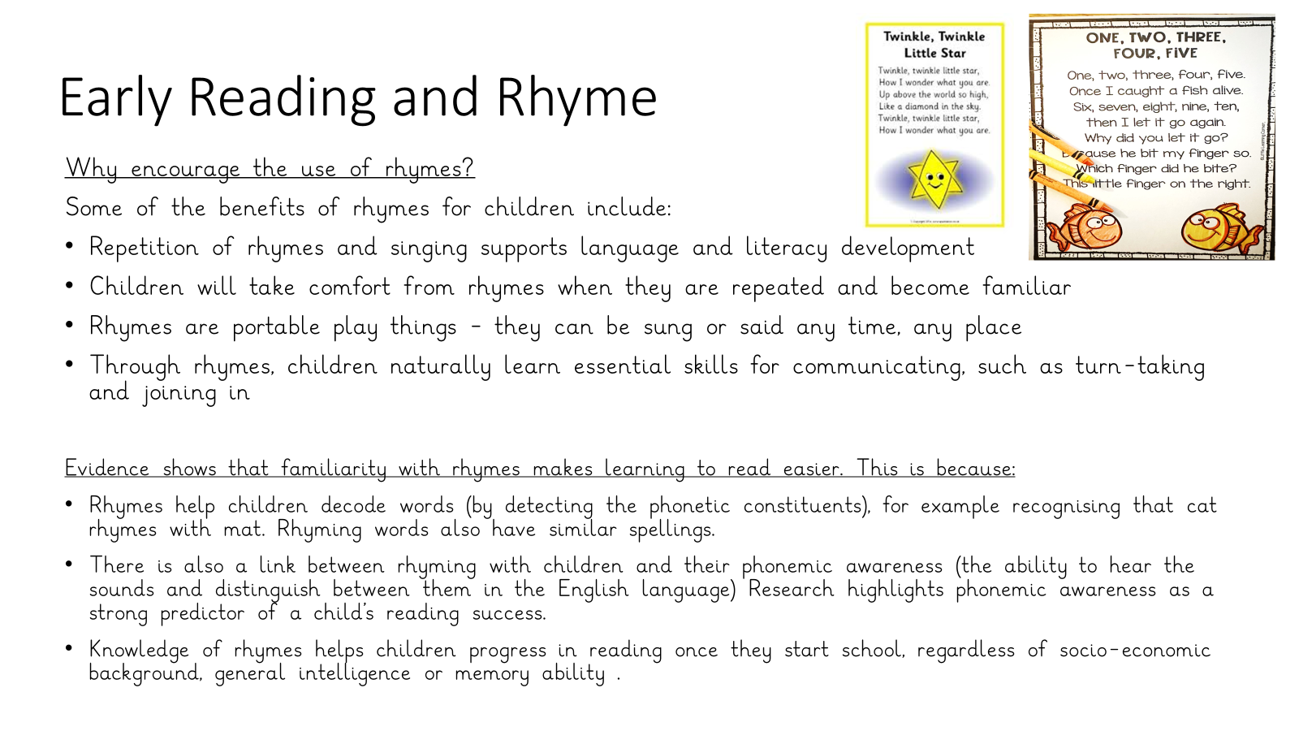
Notes:
Phonics – Following the read write inc program, but at a pace the children are able to follow and be successful. Only then will we move on to new sounds.
Read Write inc.
During our phonics input we will be learning new sounds each week. We learn the sound the letter makes and how to write and form the letter correctly. We also learn how to blend and segment the sounds to help us read & spell.
We will start to send home learnt sounds to practise with your child. Please look at these every night with your child for 5 – 10 minutes.
Phonics Workshop DATE
Reading
Chn should be heard to read everyday at home
They will do guided reading (group adult led reading) and individual reading in school
We will hold reading workshops during the school year

Slide 12

School prayers
Notes:
School Prayers on Website? Joining in school prayers
We are a Catholic school and we pray regularly during the school day. This gives the children quiet time to talk to God, to say thank you and to ask for help. It will help your child enjoy prayer time if they understand what prayer is and they are able to sit quietly during prayer time. You can help by saying family prayers together at home. You can also practice saying the school prayer with your child before they start school.

Slide 13
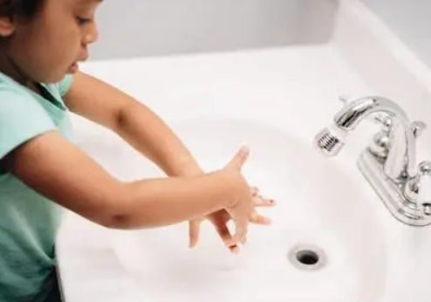

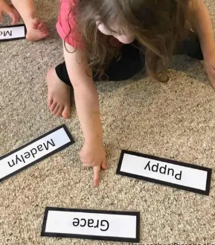
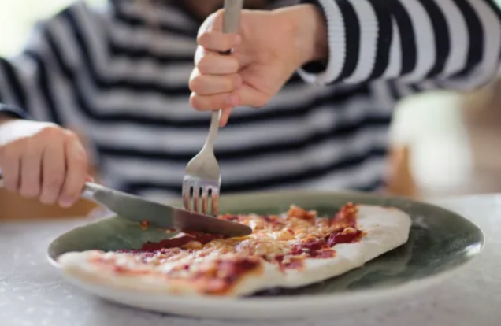
How you can help your child?
Notes:
Only use a capital letter for the first letter in their name. All of the other letters should be in lower case. Your child is not expected to recognise letters and numbers when they start school, but it will help them if they can recognise their own name. They will see it written on their coat peg and school uniform and belongings, so recognising their own name will help them to identify their own things. They will also write their name on any work they do. You can help them by practicing writing their name with them before they start school. Start by getting them to trace over their name, and place name labels around your home so they can find and recognise them.

Slide 14
Questions?
Notes:
Specific concerns to be addressed to the teachers at the end – ADD Email addresses

