Slide 1

Meet the Teacher evening
2026

Slide 2
Welcome to Year 6!
Mrs Bloom
Support staff: Miss Wysocka.

Slide 3
Overview of tonight
Lessons and assessments
Subjects covered
SATs
Homework
Routines and systems
Uniform
Snacks and Lunch
Parent/Teacher communication procedures
Trips
Home reading
Expectations in Year 6

Slide 4
Aims
Cater to every child's needs.
Provide challenge and success in learning.
Provide a means to enable all to access the learning.
Provide a safe and happy learning environment.

Slide 5
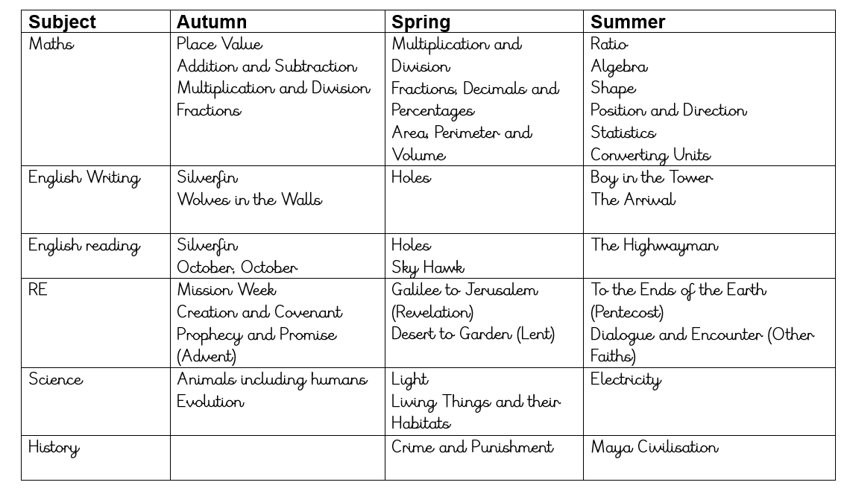
Subjects covered in Year 6
Computing
History
Maths
Art / D & T
English
PE
Spanish
Science
Geography
PSHE
Sport
RE
Music

Slide 6
National Curriculum Tests – SATs 10th May
Day-by-Day Breakdown
Monday 10 May 2027: Grammar, Punctuation, and Spelling (SPaG) paper
Tuesday 11 May 2027: Reading paper
Wednesday 12 May 2027: Maths Paper 1 (Arithmetic) and Maths Paper 2 (Reasoning)
Thursday 13 May 2027: Maths Paper 3 (Reasoning)

Slide 7
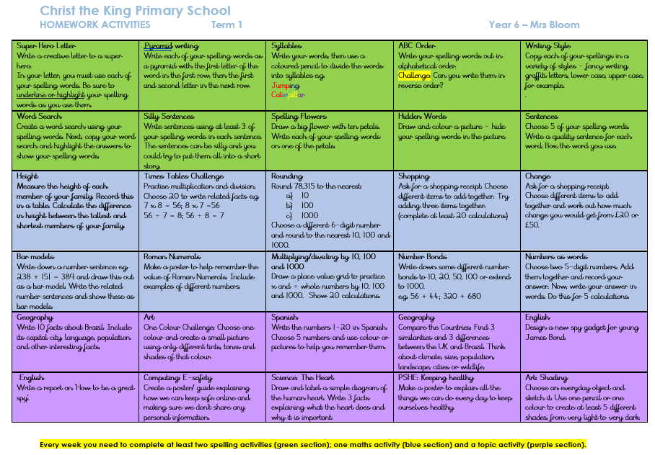
Homework
The new homework table
- Read Theory/TTRS/reading
Other homework tasks as appropriate.

Slide 8
Routines and Systems
Text messaging service – please make sure we always have up-to-date contact details.
Letter/email to your child’s teacher with any concerns.
Walking home - letters must be returned to class. This can obviously change throughout the year.

Slide 9
Uniform
Smart uniforms please – please ensure this is named - No trainers
Children to bring their PE kit to school in on Monday and then taken home on Friday – house colour t-shirt, blue shorts or tracksuit bottoms (no football shirts)
PE for my class is every Friday.

Slide 10
Snacks and Lunch
Please ensure a healthy snack is brought in for break time
As a school we encourage healthy eating and appreciate your support with healthy lunches
If you have any concerns that your child may not be eating properly, or finishing all their lunch, please let us know. We will keep you informed if we have any concerns in school.

Slide 11
Parent / Teacher Communication
Parent evenings – Autumn Term
Parent evenings – Spring Term
Reports – Summer Term
Newsletters
Website –www.christthekingreading.co.uk
If you do have any concerns about your child, we are available after school in the playground. Or alternatively, please contact the office to arrange an appointment.

Slide 12
reading at home
During the first few weeks of term, reading assessments are
carried out to determine your child’s reading level.
Once these are complete, your child will choose a reading book correctly matched to their reading level.
It is essential that your child reads every day.
Children must bring their reading book to school every day. They will need it during different parts of the day.
Once they have read their book, they will complete a short online quiz about their book. Teachers will track their progress carefully and children have chances to win prizes in assembly for their progress!

Slide 13
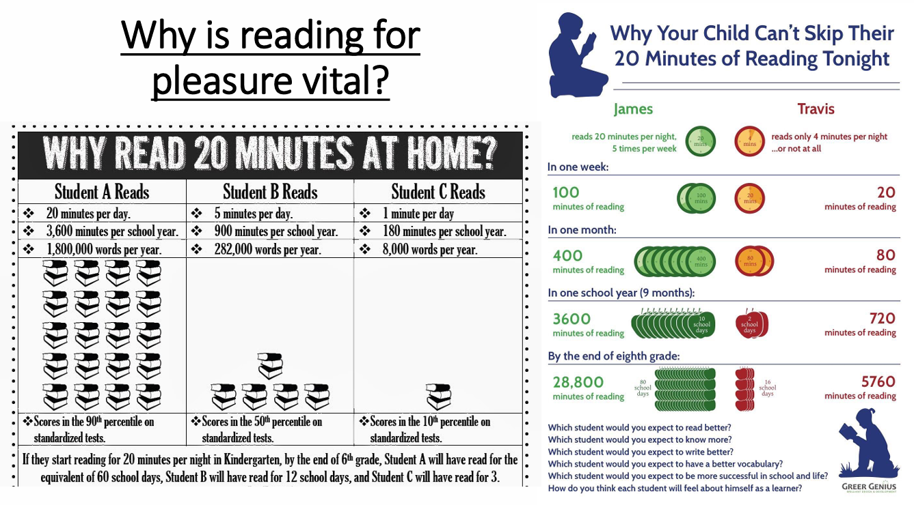

Slide 14
Expectations in Year 6
For even the most confident of pupils (and their parents!), the move into Year 6 can be a daunting time, but it really doesn’t have to be. Being in Year 6 truly is the most memorable time in your child’s primary education. Year 6 is a key moment in your child’s life; they will develop more independence, a huge amount of resilience and, most importantly, they should become very aware of who they are as both learners and as young adults.
We do hope they will rise to the challenge!

Slide 15
Y6 trips
Enrichment week!

Slide 16
From you…
Letters for collection arrangements
Information regarding absence
If your child is to be excused from PE
Absence requests
Through calling the office or a letter to us which we’ll forward to the office.

Slide 17
Thank you for coming!
Any questions?

